Slide 1

Dynamic Causal Modelling
Abdoreza Asadpour

Slide 2
State Space Model (SSM) popular as Dynamic Causal Model (DCM)
For EEG-fMRI
Valdes-Sosa, P. A., Sanchez-Bornot, J. M., Sotero, R. C., Iturria-Medina, Y., Aleman-Gomez, Y., Bosch-Bayard, J., Carbonell, F., & Ozaki, T. (2009). Model driven EEG/fMRI fusion of brain oscillations. Human Brain Mapping, 30(9), 2701–2721. https://doi.org/10.1002/hbm.20704

Slide 3
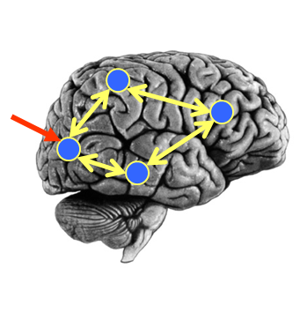
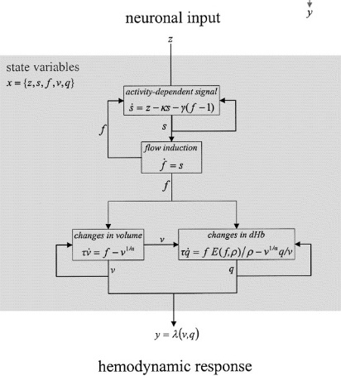
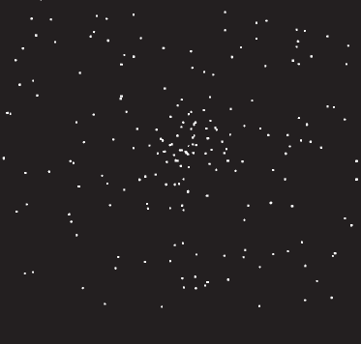
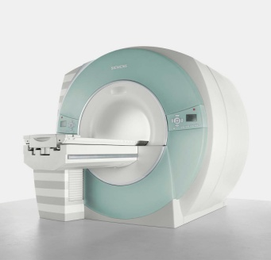
DCM Framework
Neural Model
Observation Model
Experimental Stimulus (u)
Observations (y)
How brain activity z changes over time
What we would see in the scanner, y, given the neural model?
.
z = f(z,u,θ^{n})
y = g(z, θ^{h})
Stimulus from Buchel and Friston, 1997
Figure 3 from Friston et al., Neuroimage, 2003
Brain by Dierk Schaefer, Flickr, CC 2.0

Slide 4
DCM Framework
Neural Model
Observation Model
Experimental Stimulus (u)
Observations (y)
Model Inversion
(Variational Laplace)
Given our observations y, and stimuli u, what parameters θ make the model best fit the data?

Slide 5
Single Source Model for EEG/MEG
David, O., Kiebel, S. J., Harrison, L. M., Mattout, J., Kilner, J. M., & Friston, K. J. (2006). Dynamic causal modeling of evoked responses in EEG and MEG. NeuroImage, 30(4), 1255–1272. https://doi.org/10.1016/j.neuroimage.2005.10.045

Slide 6
Sample Task
Mismatch Negativity (MMN)
Standard Stimulus
1000 Hz
80% (480) trials
Rare Stimulus
2000 Hz
20% (120) trials
70 ms
5 ms rise and fall time
70 ms
5 ms rise and fall time
Garrido, M. I., Kilner, J. M., Kiebel, S. J., Stephan, K. E., & Friston, K. J. (2007). Dynamic causal modelling of evoked potentials: A reproducibility study. NeuroImage, 36(3), 571–580. https://doi.org/10.1016/j.neuroimage.2007.03.014

Slide 7
Recorded EEG signal analysis
5s epoched from − 100 to 400 ms after the stumulus onset
Bandpass filtered [0.5, 40] Hz
re-referenced to the average of the right and left ear lobes
DCM
down-sampled to 200 Hz
Garrido, M. I., Kilner, J. M., Kiebel, S. J., Stephan, K. E., & Friston, K. J. (2007). Dynamic causal modelling of evoked potentials: A reproducibility study. NeuroImage, 36(3), 571–580. https://doi.org/10.1016/j.neuroimage.2007.03.014

Slide 8
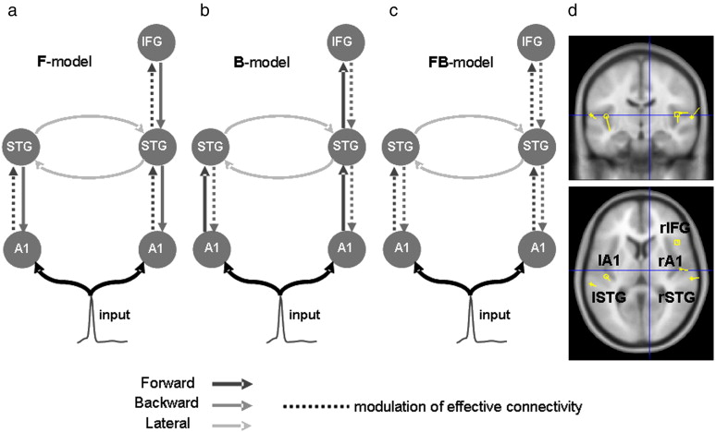
DCM space model
Garrido, M. I., Kilner, J. M., Kiebel, S. J., Stephan, K. E., & Friston, K. J. (2007). Dynamic causal modelling of evoked potentials: A reproducibility study. NeuroImage, 36(3), 571–580. https://doi.org/10.1016/j.neuroimage.2007.03.014

Slide 9
DCM analysed data
In SPM website
https://www.fil.ion.ucl.ac.uk/spm/data/eeg_mmn/

Slide 10
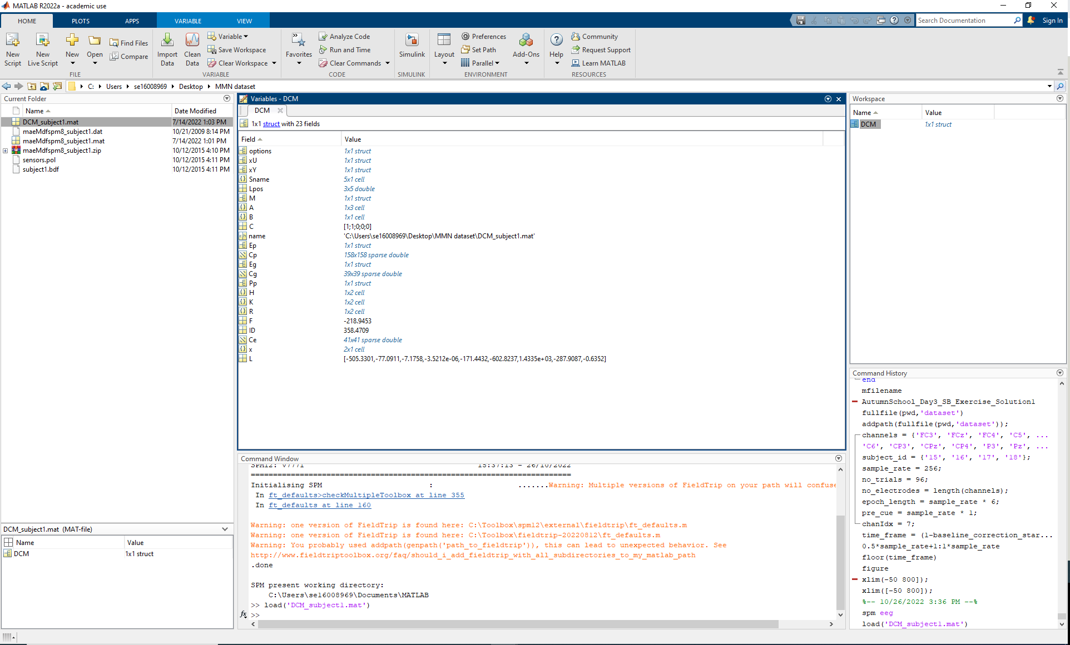
Exercise
Download, unzip and add spm12 to Matlab
Use Set Path, Add Folder

Slide 11
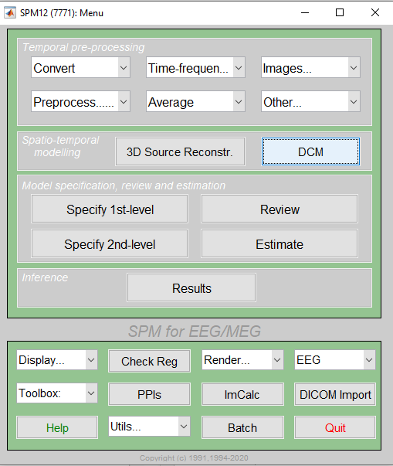
Exercise
Type “spm eeg” in Matlab command line
Click on DCM

Slide 12
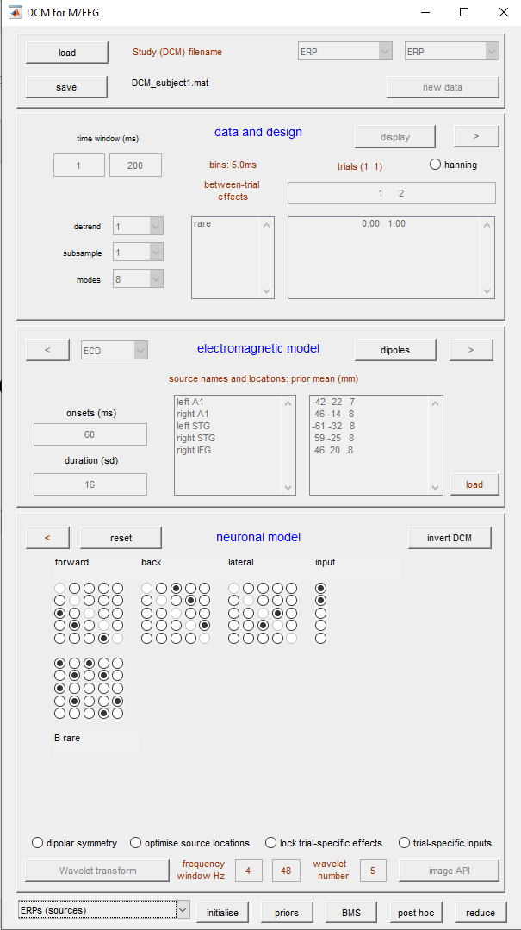
Exercise
1
Click on Load and open “DCM_subject1.mat”
Select “ERPs (sources)”
2

Slide 13
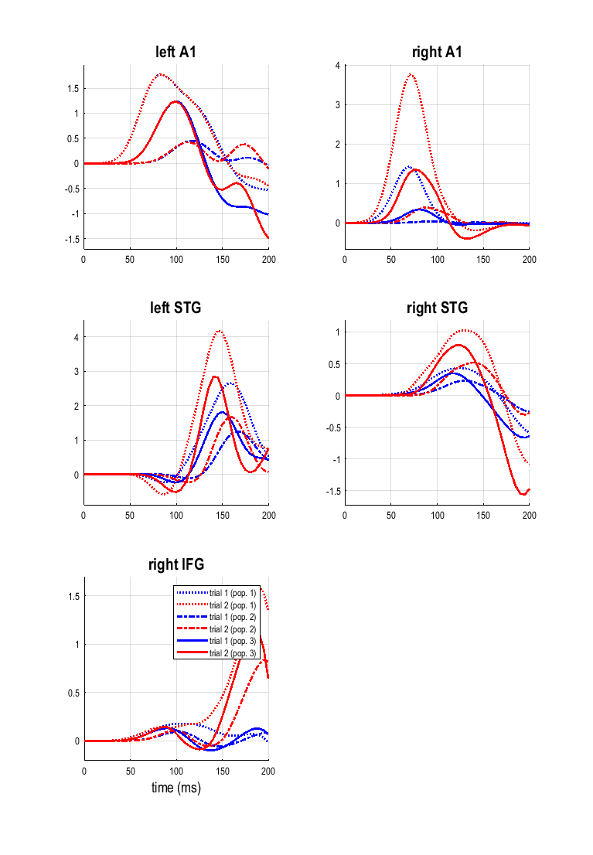
Population Activities

Slide 14
Exercise
Select “Scalp maps”
1

Slide 15
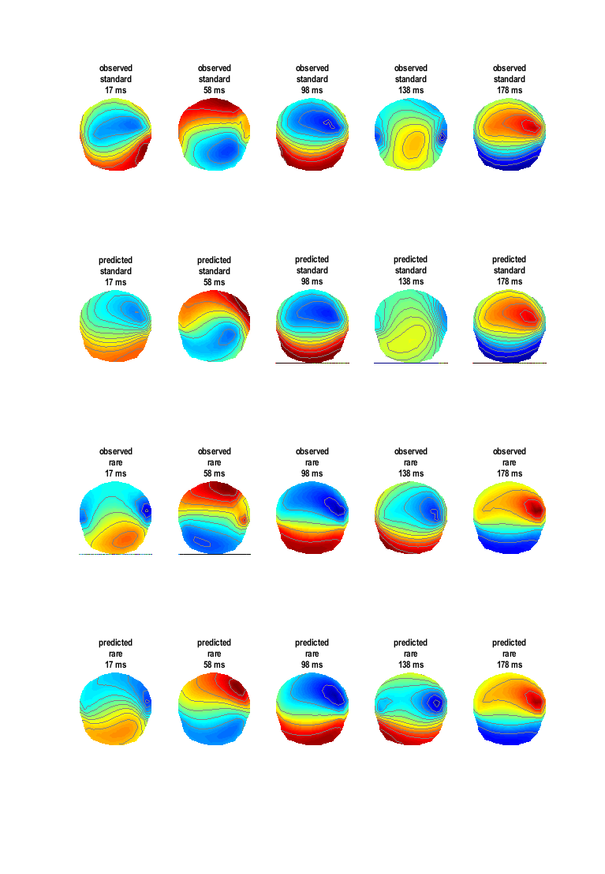
Scalp Maps (standard and rare conditions)

